Slide 1
MOLECULAR BIOLOGY LABORATORY
BT 453
Laboratory No. 2
DNA Isolation
MBL. BT453

Slide 2
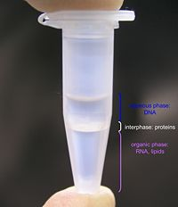
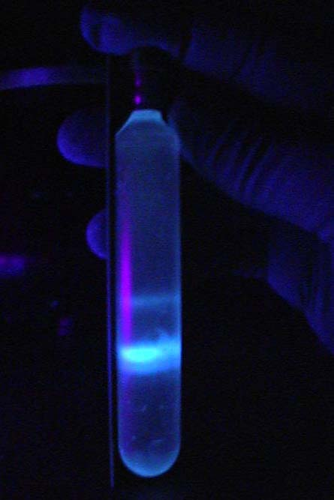
Types of Methods
Differential solubility
  Organic solvents
  Salting-out
Adsorption methods
Density gradient centrifugation
openwetware.org/wiki/Phenol/chloroform_extraction
https://classshares.student.usp.ac.fj
MBL. BT453

Slide 3
Differential solubility / Salting-out (Promega Kit)
A
Cell lysis solution
Hypotonic solution for Red blood cells osmolysis
Nuclei lysis solution
Salt so that DNA is stabilised and remains as a double helix.
Detergent which disrupts the lipid layers, helps to dissolve membranes & binds positive charges of chromosomal proteins (histones) to release the DNA into the solution.
Elevated temperature 80ºC to denature proteins and inhibit degradation of DNA by DNAses).
B
Protein precipitation solution
Salt- precipitate proteins & lipids
C
MBL. BT453

Slide 4
Differential solubility / Salting-out
DNA precipitation by isopropanol/ethanol & sodium salt
Sodium Salt – Na+ ions bind to DNA, decreasing its negative charge allowing DNA molecules to come closer together and spool. NaCl is to keep the DNA in its double helix form, otherwise it would denature and become "ssDNA”.
Alcoholol – precipitate DNA which is repelled by nonpolar solutions.
D
DNA washing by 70% ethanol
70% ethanol - Wash the DNA to remove residual salts and other contaminants.
E
Air drying & DNA Rehydration Solution(TE)
Air drying removes ethanol
TE dissolve DNA pellet
F
MBL

Slide 5

Differential solubility / Salting-out
A
B
C
Add cell lysis buffer then centrifuge
Remove blood & resuspend in nuclei lysis solution
Add protein preciptation solution
WBCs
Proteins & lipids
Fresh blood
Lysed RBCs
intact WBCs
Lysed WBCs
Proteins & lipids precipitated , DNA in solution
MBL. BT453

Slide 6
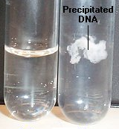
Differential solubility / Salting-out
D
E
F
Supernatant
70% EtOH
Add alcohol & salt
Centrifuge
Wash
Centrifuge
Pellet
Dissolve pellet
DNA Rehydration Solution(TE)
Before
After
Aqueous phase containing DNA
MBL. BT453

Slide 7

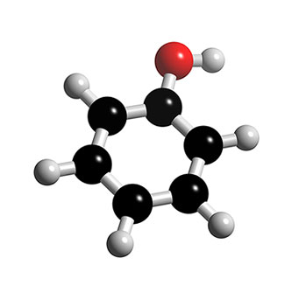
Problems
Shearing of DNA
DNases
Chemicals
MBL. BT453

Slide 8
Laboratory No. 1
Fresh Blood
RBCs lysis
WBCs Lysis
Protein precipitation
DNA precipitation
DNA rehydration & storage
DNA Washing
MBL. BT453

Slide 9
WORK FLOW CHART
LABORATORY NO. 3 &4
LABORATORY NO. 1&2
Bacteria
Animal cells
Bacteria
Blood
Plasmid
RNA
DNA
DNA
LABORATORY NO.5
Quantitation & Analysis
Agarose Gel electrophoresis
Spectrophotometer
Nanodrop
MBL. BT453

